Slide 1
Workshop 4
The python and R workshop

Slide 2

My philosophy on teaching coding:
Move as many things (packages, tools, use cases etc) from the “unknown unknowns” to the “known unknowns”.
You won’t remember how to use any package, but you might remember it exists!

Slide 3

AI and Coding
Back in my day we used random code we didn’t understand the *right* way
AI tools are really good at coding!
Ask yourself; is it important to me that I learn how to do this?
Very useful case; ask it to debug (“find the errors for me”)

Slide 4
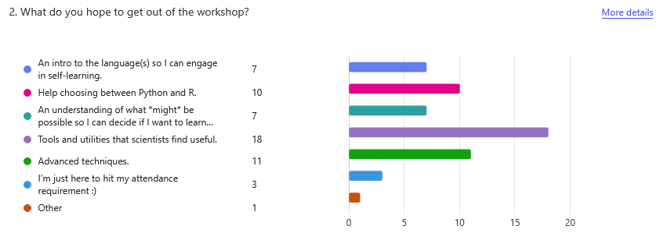
I asked, you answered;

Slide 5
My Programming Experience
Python:
Taught 3rd year computational physics
Lots of bulk data processing and analysis in PhD
Small amounts of experiment interfacing and webscraping
I learned python because I couldn’t afford Matlab
C++:
Brownian motion simulations!
Optmisation of said simulations (multi-threading)
R:
- Never used it

Slide 6
Workshop Plan
What’s a Package, What’s an IDE?
Intro to Python: getting it, learning it, using it.
Intro to R: getting it, learning it, using it.
Python or R? The Age Old Question
Useful packages in python and R
(Overflow); Nerding out with Tom (using the other presentation)

Slide 7
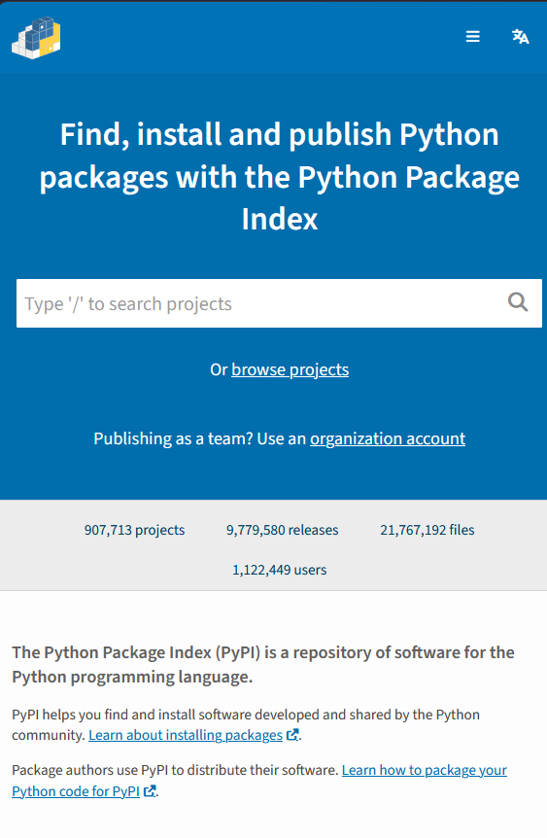

A Package
Python and R have some nice base functions, but the reason they’re so popular are packages.
Lots of people have written lots of really useful code and put them up for free!
Knowing how to find and use good packages is basically the entire objective.

Slide 8
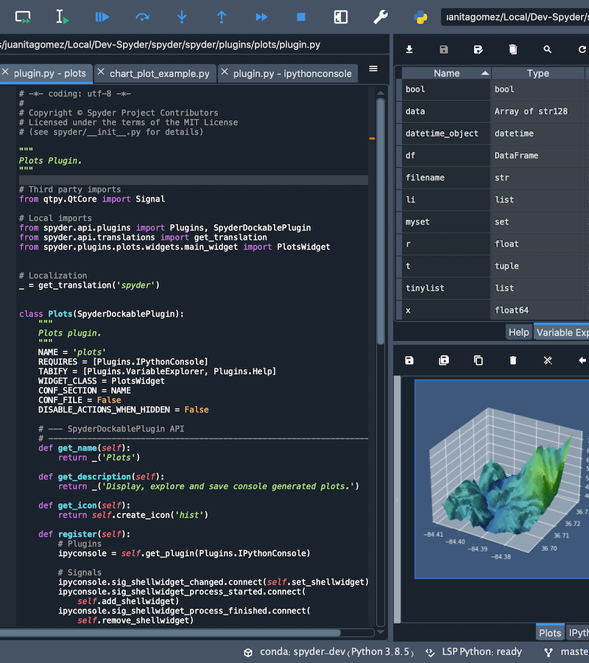

An Integrated Development Environment (IDE)
Normally, the code runs and you only see the output. This means it’s hard to see what it’s doing.
An IDE lets you;
See the code
Run the code
See the output
See all the variables and bits and pieces
Use useful debug tools
STRONGLY recommend using an IDE!
(We’ll see some)

Slide 9
Python!
Useful for:
TBH Damn near everything
Data processing / handling
Making pictures and plots
Doing simulations
Machine Learning

Slide 10
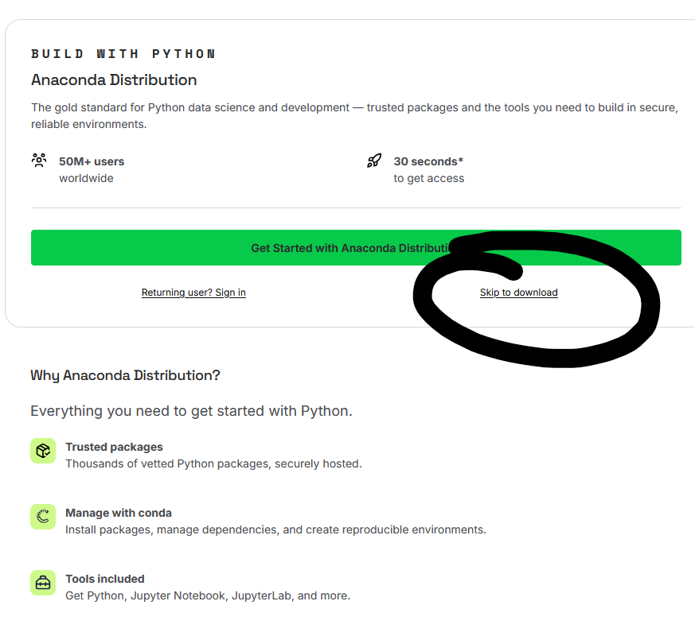
Installing Python
Many recommendations. My personal is Anaconda (installs a lot of packages for you)
It comes with the Spyder utility.

Slide 11
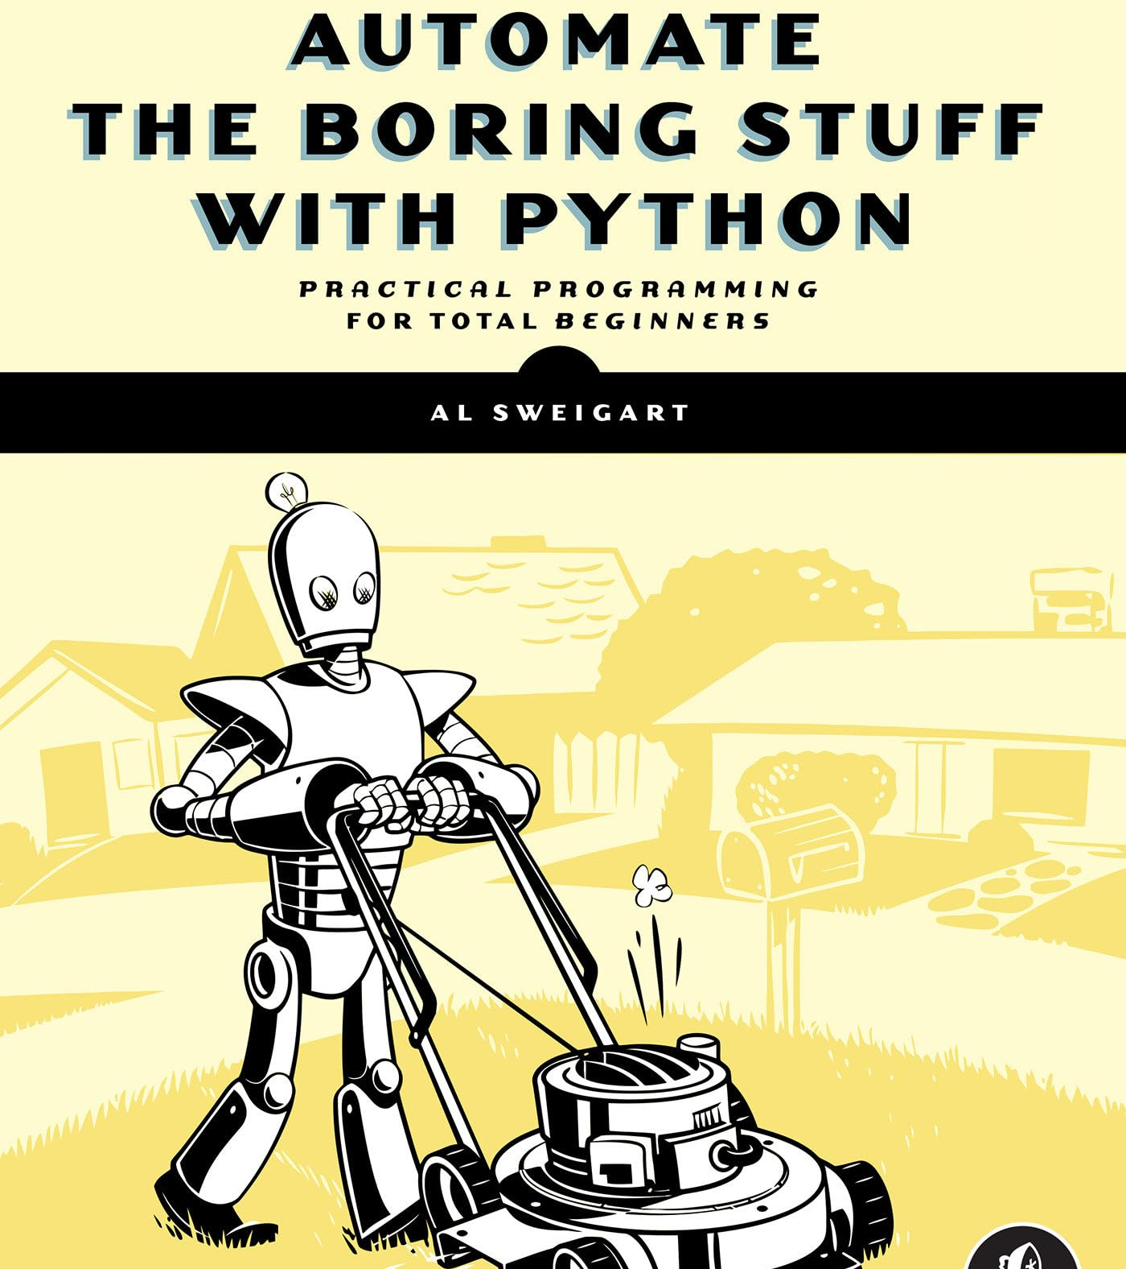
Learning Python
Go to automatethboringstuff.com
It’s a free book – scroll down to see the chapters.
It’s how I learned python, I strongly recommend it!

Slide 12

R!
Excellent at data processing and statistical analysis.
Efficient and fast!
OK at other things.

Slide 13
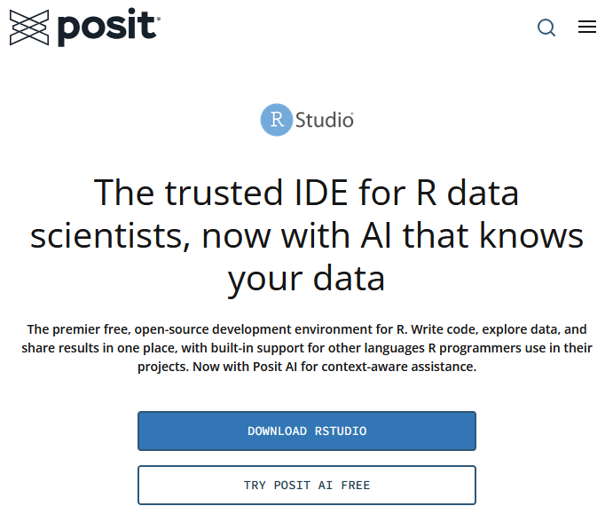
Installing R
First, go to cloud.r-project.org
(this is the language)
I’d recommend then going to “R Studio” online and downloading that as an IDE and package manager.

Slide 14
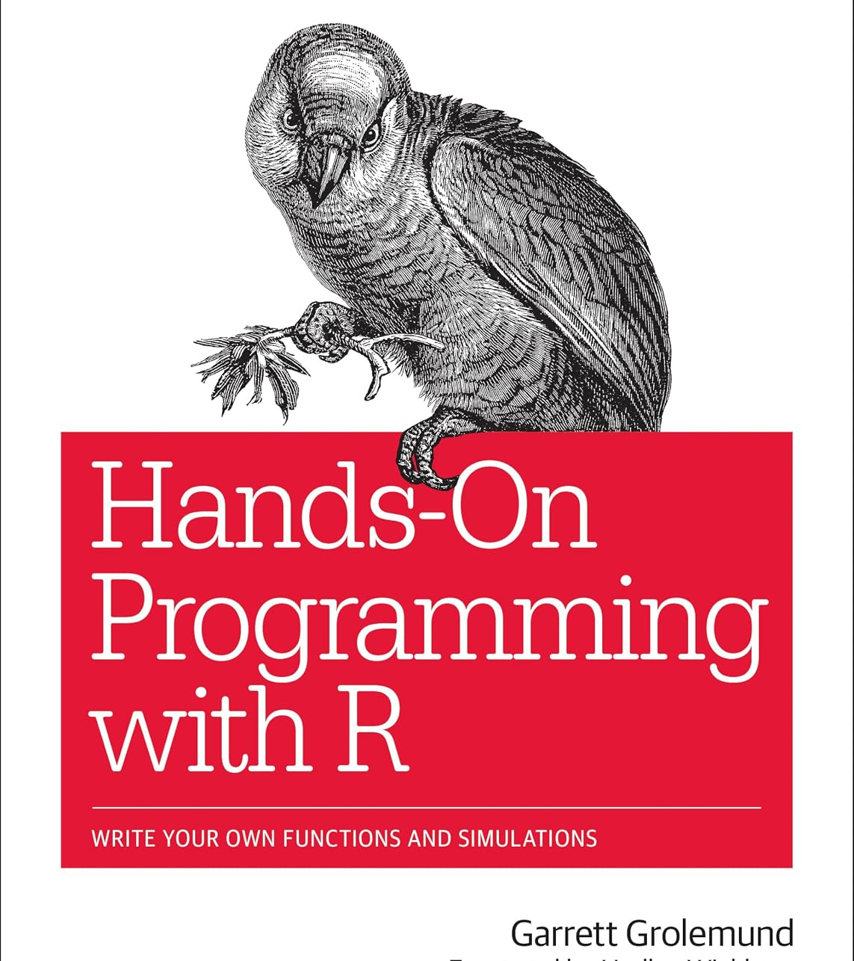
Learning R
Hands-On Programming with R is available for free online (https://rstudio-education.github.io/hopr/index.html)
Garrett Grolemund has been working at Rstudio for over a decade.

Slide 15
Instlallation Break
(Go install stuff)

Slide 16
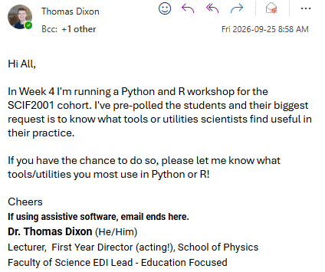
Packages!
I asked my colleagues what they found most useful!
Here, I’ll be listing out some bangers (each with a page).

Slide 17
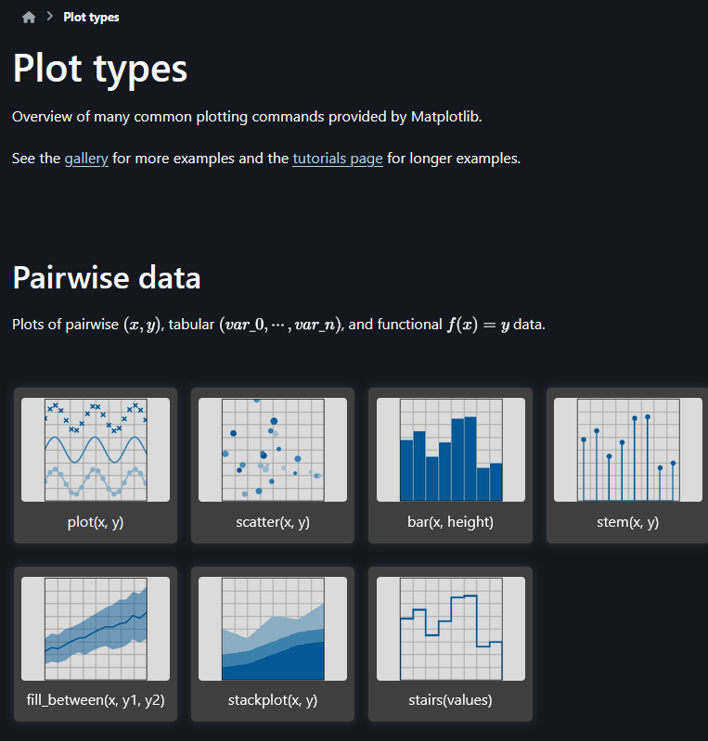
The Big three in python
EVERYONE Uses these
Numpy
Numerical Python computing tools.
Has all the basic number management functions, like;
Creating matrix / vector arrays
Random number generating
Sorting
Many packages depend on it.
Scipy
Scientific algorithms!
Optimisation
Curve fitting
Statistical analysis
Signal processing
Image processing
For most of your work, there will be a relevant SciPy Function!
MatPlotLib
THE plotting tool. Makes pictures, is exceptionally good at it.

Slide 18
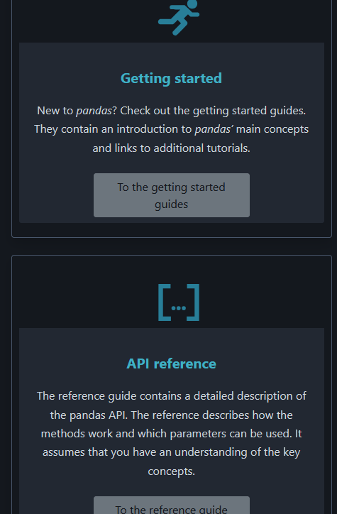
PANDAS
A very robust and versatile data manipulation tool.
Great for when you have large sets of data, especially if there’s a mix of data types and/or the data are kind of ugly!
Head to Pandas’ Getting Started Guide for more info

Slide 19
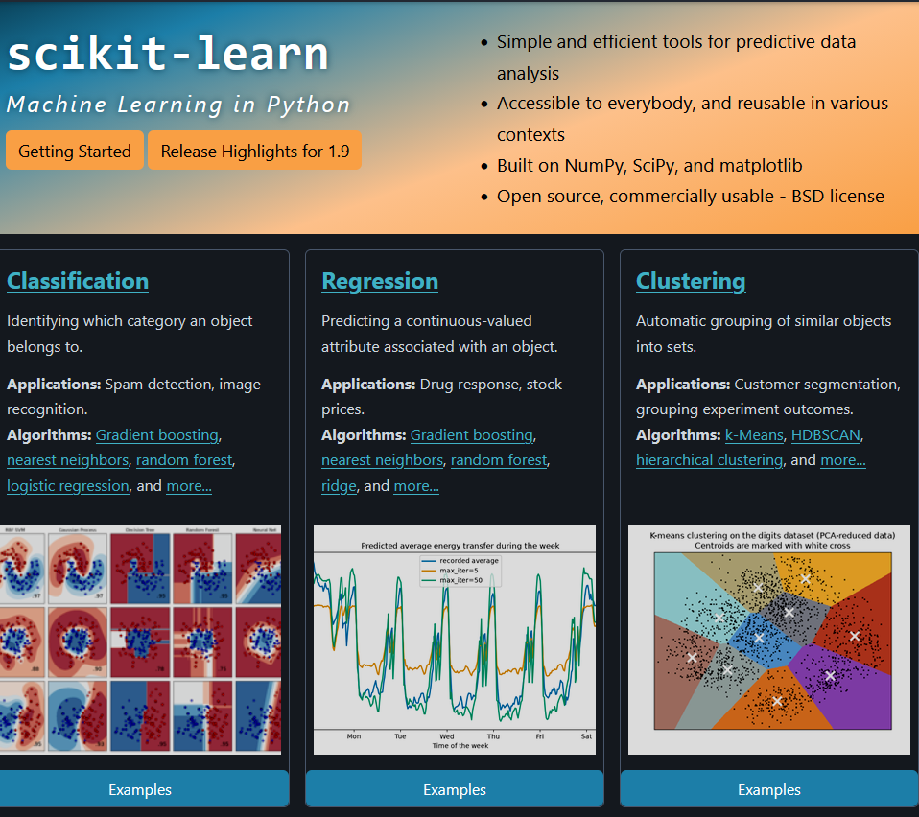

Scikit-learn

Slide 20
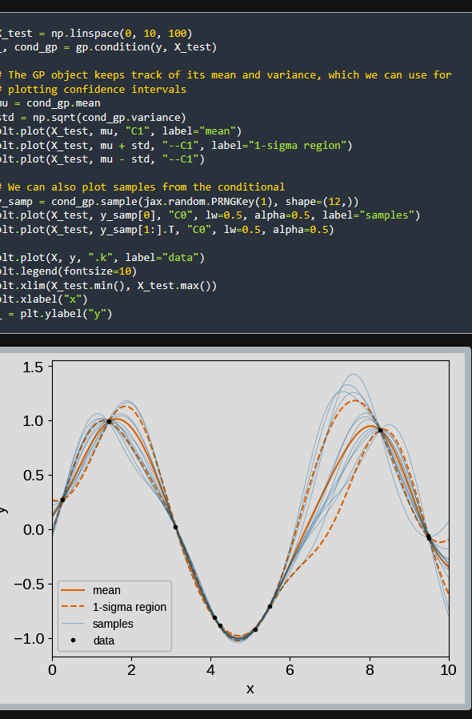
TinyGP and EMCEE
Two very lightweight (i.e. not-bloated) packages for Markov Chain Monte Carlo (MCMC) simulation and other Gaussian Process modelling.
Basically if you’ve got to do something involving randomness and you need to do a lot of it, these packages can help.
Ben might be able to say more

Slide 21
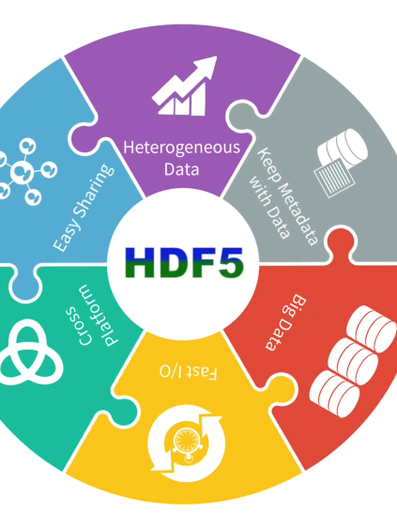
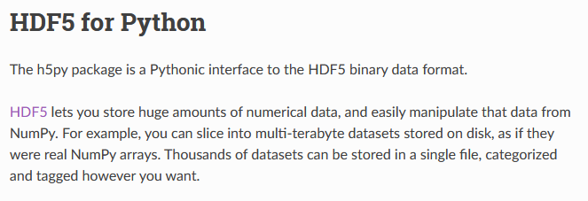
HDF5 Python
HDF5 (Hierarchical Data Format 5) is a format some fields store data in.

Slide 22
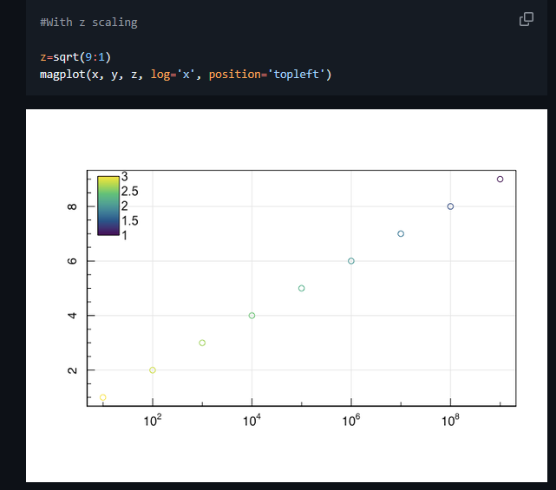
Magic Axis
An R plotting library.
Simple to use and full of nifty functions!
Good for making nice plots.

Slide 23
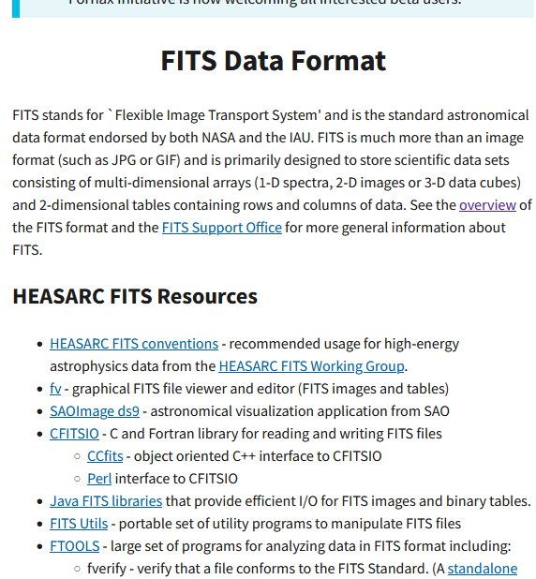
Rfits
Manipulating another file type – FITS (common for astro)
R Fits lets you handle those data types ☺

Slide 24
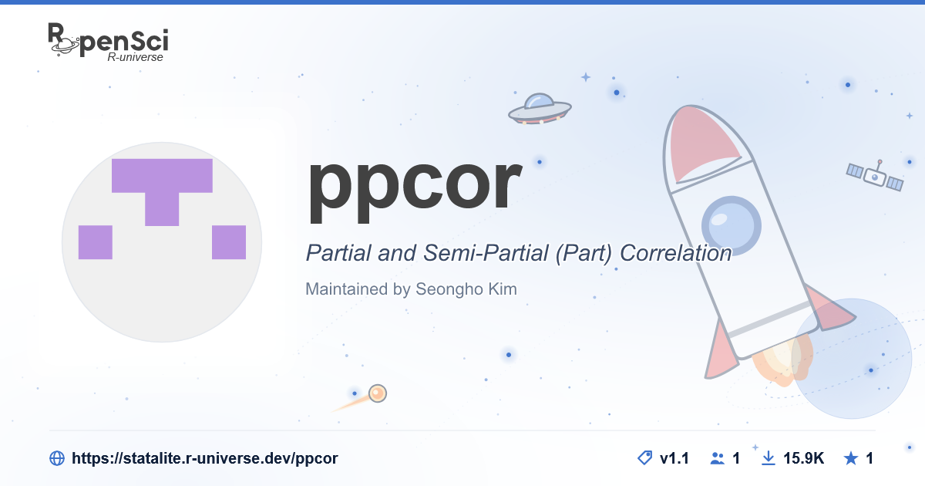
PPCOR + RSTAN
Correlation and Statistical Analysis tools!

